Slide 1
Introduction to the DevOps Team What do we do?
Sarah Foxley, Scientific Software Engineer
Mantid Developer Meeting 2023 at ORNL
17th October 2023

Slide 2



What is the DevOps Team?
A virtual team of volunteers
Based at ISIS
Working to improve the developer operations for the Mantid project
Expertise in
Jenkins
Ansible
Docker
Conda

Slide 3
What we do
Maintain the Linux, Windows and OSX Jenkins runners that are based at STFC
Maintain the CI pipelines
Maintain the nightly pipeline
Keep Jenkins and Jenkins plugins up to date
Pin Conda dependencies that break the CI/Nightly pipelines
Maintain the Linode server and services it hosts
Mantid Forum
Mantid e-mail lists
Usage Reporter
Error reporter
Mantid website

Slide 4
What we do not do
Maintain Jenkins runners hosted at other facilities
Fix conda dependency issues
Fix unreliable tests
Fix PRs that break the nightly pipeline

Slide 5
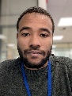
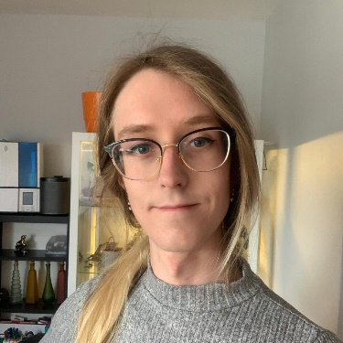
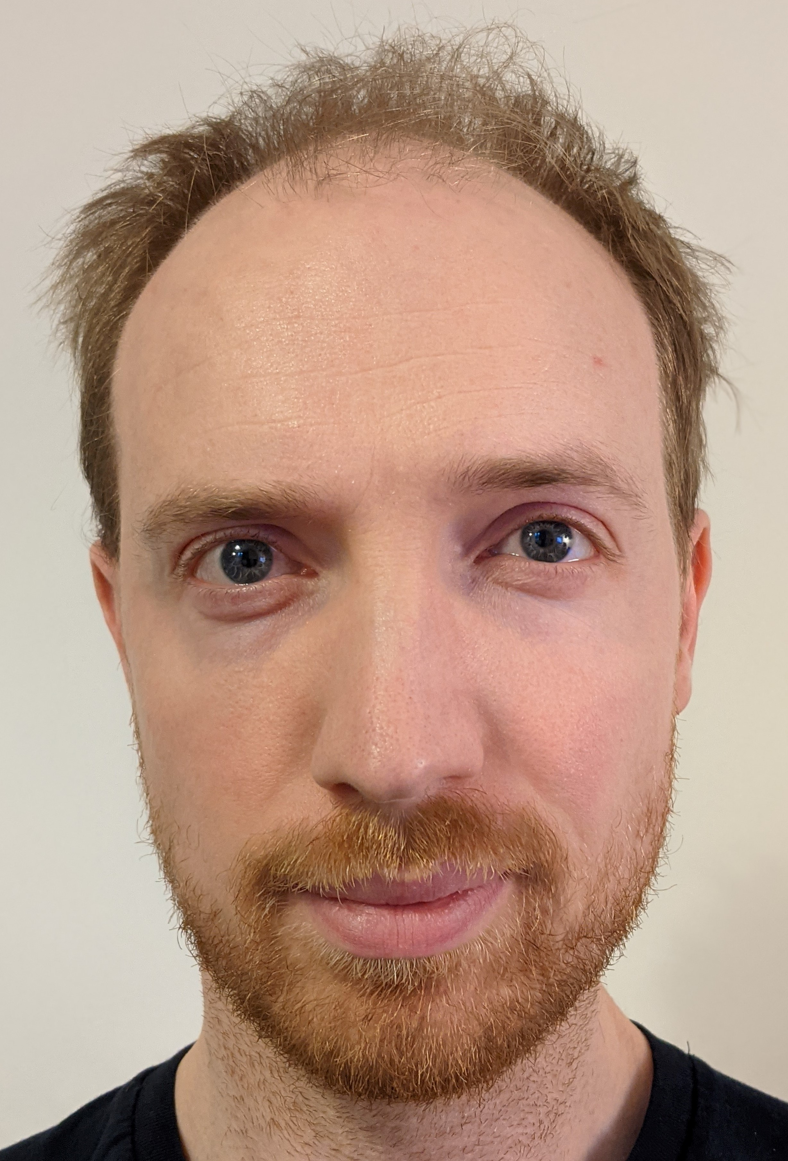
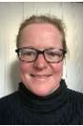
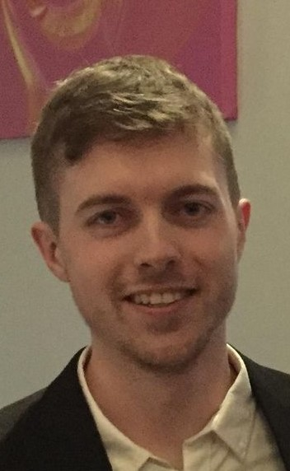
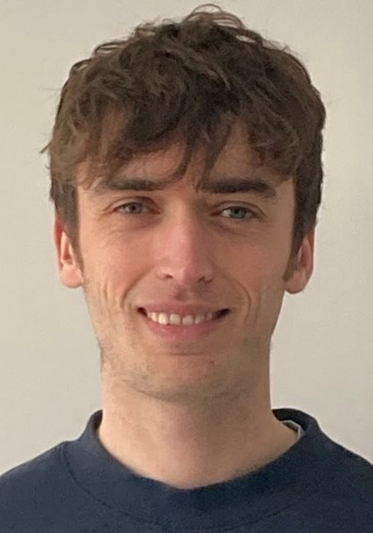
The DevOps Team
Mohammed Almakki
Conor Finn
Thomas Hampson
Silke Schomann
Robert Applin
Sarah Foxley
Mial Lewis

